Slide 1
Preparing Future Lawyers to Find Their Inner Veronica Mars: Teaching students how to use Facebook, Twitter, and other social media for investigative purposes in legal practice
Examples of how Facebook, Craigslist, eBay, and other popular web destinations are used in legal practice
Ethical and practical matters that lawyers need to consider when attempting to use social media evidence in court
How you can bring this timely topic into the classroom and help your students develop a valuable skill set

Slide 2
This is happening. And it’s important.

Slide 3
This is Happening. And It’s Important
Griffin v. State, 419 Md. 343 (2011): authentication of electronic communications (MySpace messages) based on the content and circumstances of those communications is acceptable
Tienda v. State, 358 S.W.3d 633 (2012): Defendant convicted of murder due in part to postings he had made on his MySpace page
Dexter v. Dexter, 2007 WL 1532084 (Ohio Ct. App. May 25, 2007)): Postings on MySpace page by Defendant discussing drug use were significant factor in loss of custody
Lalonde v. Lalonde, 2011 WL 832465 (Ky. Ct. App. Feb. 25, 2011): Facebook photos showing mother drinking were properly admitted into evidence in a child custody dispute with father, even though she had not posted them or given permission to be tagged in them, because they accurately reflected her activities

Slide 4
Now, how can you help your students understand this new kind of legal research?
Demonstrate relevance
Provide strategies
Frame issues in both practical and ethical terms

Slide 5
1. Demonstrate Relevance
How can attorneys use this type of information?
Research potential jurors during voir dire
Look for photos of undisclosed assets during bankruptcy proceedings
Evidence of activities in personal injury cases
Evidence of relationships or questionable activities in divorce or custody cases
Documentation of criminal activities—theft, assault, or illicit activities
Metadata can help establish location for alibis (or not!)

Slide 6
This actually happened:
“Joe,” an adult male, was taunting the younger sister of “Bill,” a teenager. Bill went outside and punched Joe in the face, knocking him off his bike. Joe pressed charges, and a public defender was representing Bill when she went on the local Topix board…

Slide 7
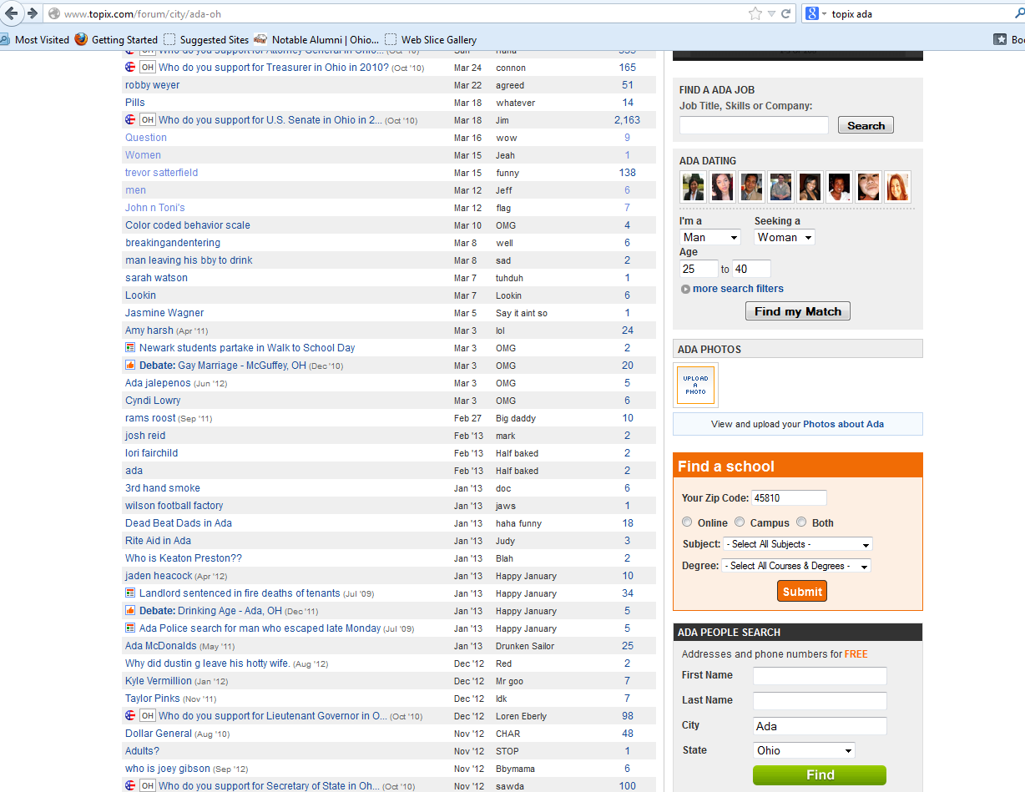
A sampling of the Ada, Ohio Topix board on March 27, 2013.

Slide 8
Depending on an attorney’s clients, cases, areas of law, these topics might be worth checking out.

Slide 9
Depending on an attorney’s clients, cases, areas of law, these topics might be worth checking out.

Slide 10
And admit it– you’re probably going to look at this one because you’re just wondering– why do people in Ada have so much to say about Dollar General?

Slide 11
Boyfriend, a sex offender, was in jail and had a (recorded!) phone call with Girlfriend, whose children were under the purview of a Guardian ad Litem. Boyfriend and Girlfriend agreed that Girlfriend would raise bail money for Boyfriend by entering the World’s Oldest Profession. The Guardian ad Litem did some investigating and made her way to the digital streetcorner, a.k.a. the Casual Encounters section on Craigslist.

Slide 12
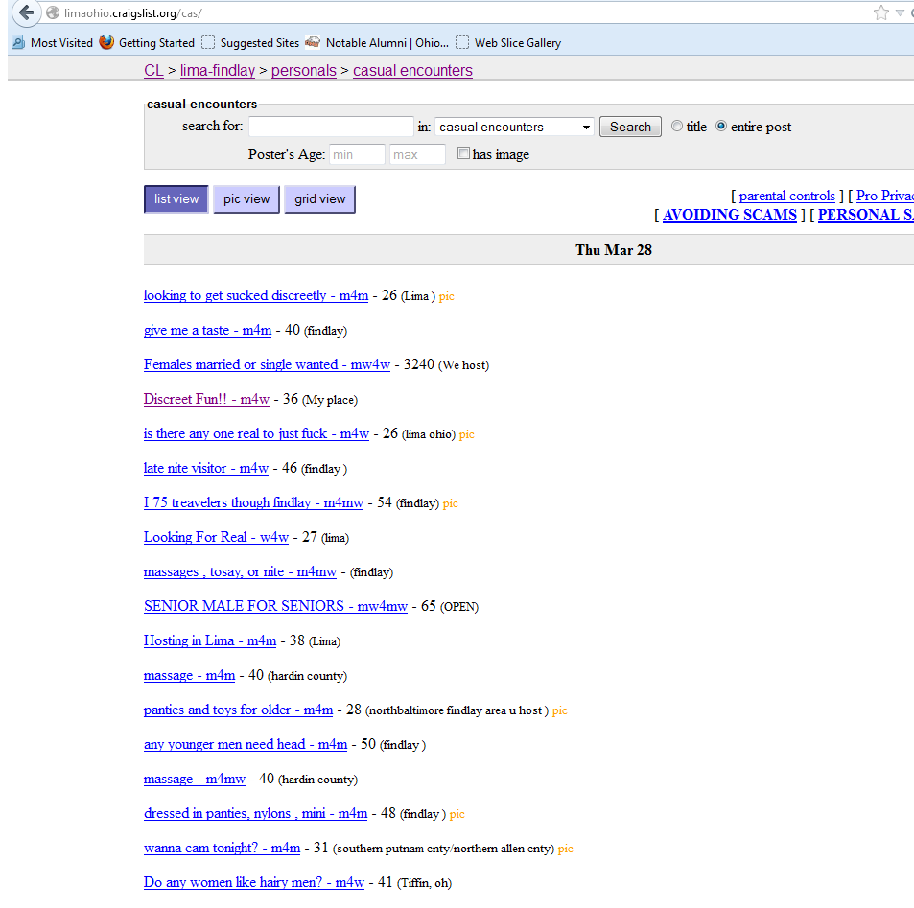
Censored because there are some legitimately filthy people on Craigslist.
From the Lima-Findlay Craigslist Casual Encounters section on March 28, 2013.
Seriously, move along. Nothing to see here. Unless you’re trying to find out if someone is prostituting herself to pay her boyfriend’s bail, in which case,
there might be something to see here after all.

Slide 13
Speaking of selling things on the internet, ebay is the new pawn shop.

Slide 14
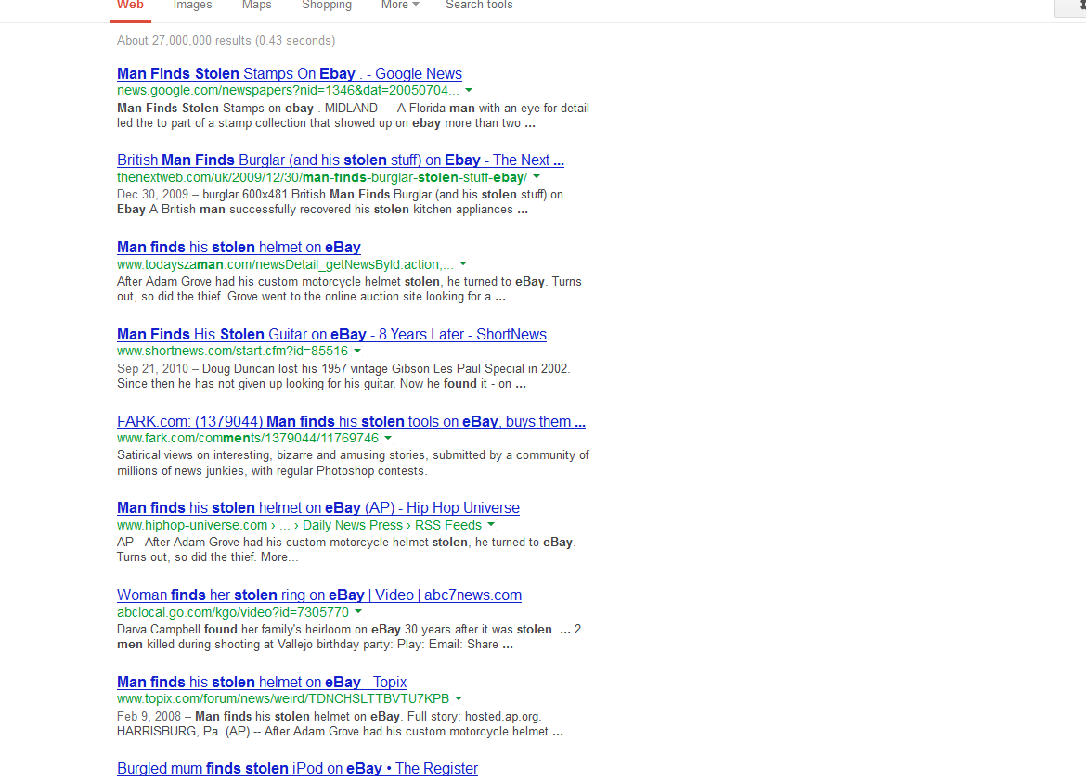
This is actually SO common that we couldn’t narrow it down to just one good example.

Slide 15
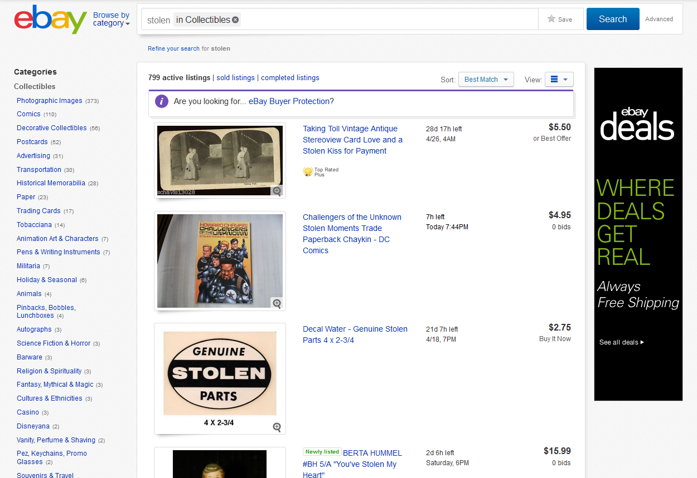
Attorneys will probably need to do searches that are slightly more sophisticated than this one.

Slide 16
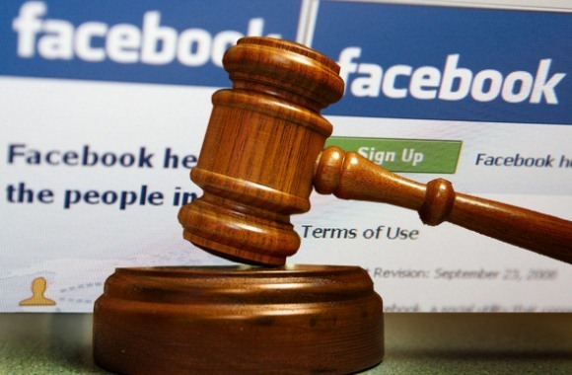
And of course, Facebook

Slide 17
Yet another thing that seriously happened:
Mother was dating a convicted sex offender; Baby was being represented by a GAL. Mother had multiple Facebook accounts, including one for Baby (and “Baby” Liked both a bar and a porn site). At her hearing, Mother swore she was no longer dating Sex Offender, and that he was therefore nowhere near Baby. Facebook, however, told a different story…
“Afterglow”
*shudder*

Slide 18
Lessons from Steubenville
Evidence can be gathered from myriad social media sites, such as those already mentioned and others like Instagram, YouTube, Twitter
Vigilante justice is both a blessing and a curse in the internet age– without blogger Alexandra Goddard, the case might never have garnered the national attention that pressed local authorities into cracking down on the rapists. But innocent Steubenville residents might have been hurt by Local Leaks (a WikiLeaks-style site that addressed the case).
Cast a wide net in terms of not just social media sites but also networks of friends. While one person might have adequately protected their postings, one of their friends might not have, giving you access to pictures, videos, etc.

Slide 19
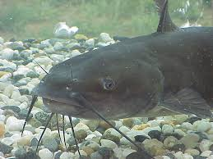
Practical and Ethical Considerations
Are your actions in pursuing evidence morally and ethically defensible?
Have you taken all necessary steps to preserve and authenticate the evidence?
Can you get the evidence admitted in court?
Notes:
If you’re making a discovery request, is your request for social media relevant or is it a fishing expedition?

Slide 20
Teaching it!
Social media research ties in with traditional legal research skills and competencies.
Make a research plan
Keep a research log
Organize your saved research

Slide 21
Make a Research Plan
Applying the (slightly modified) Rombauer Framework to Social Media Research:
Preliminary Analysis is not a waste of time
Following your Search Strategy will help make sure you don’t miss anything
Refine, Double Check, & Update

Slide 22
Preliminary Analysis
Facts
Search Terms
Issue & Jurisdiction
Search Strategy/Knowledge Assessment
Secondary Sources

Slide 23
Make a Research Plan
Facts:
What do you know? Hometown? Alma Mater? Employer?
John Smith

Slide 24
Make a Research Plan
Issue & Jurisdiction: What? (photos, video, writings) Where? When?

Slide 25
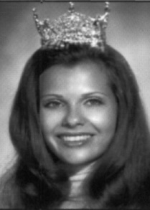
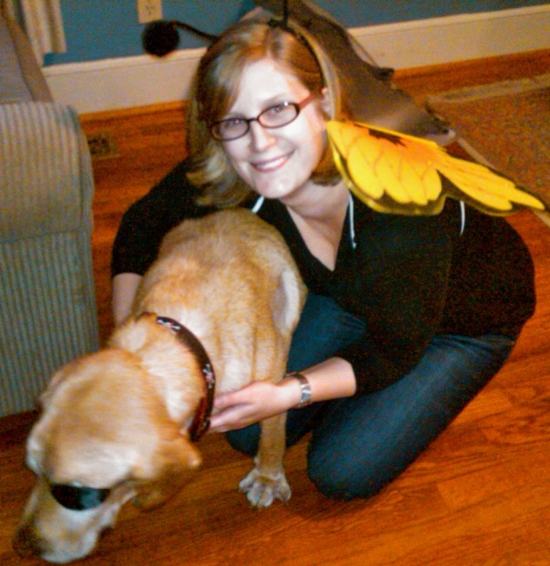
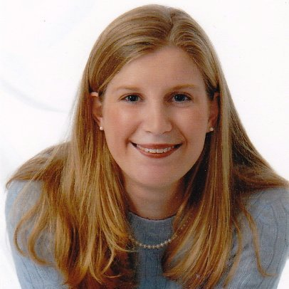
Make a Research Plan
Think about your search terms. Then think about synonyms.
“Ellen M. Richardson”
“Ellen Richardson”
“Ellen Minot Richardson”

Slide 26
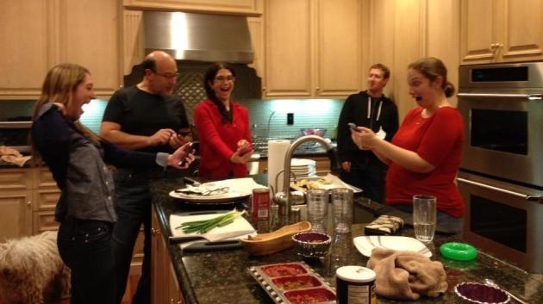
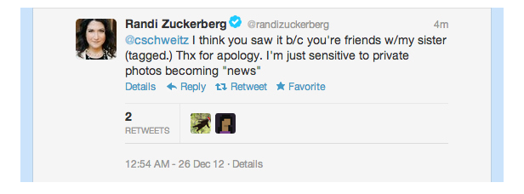
Make A Research Plan
Then, think about related terms:

Slide 27
Make a Research Plan
Finally, develop your research strategy.
“I did a few Google searches and wasn't able to come up with much so I went to the high school football Web site and made a list of names. I read a few local high school forums to get a gist of who was who and then started searching Twitter. I figured I'd see what the other kids were saying about the case. You can learn a lot through these conversations.”
-Alexandra Goddard

Slide 28
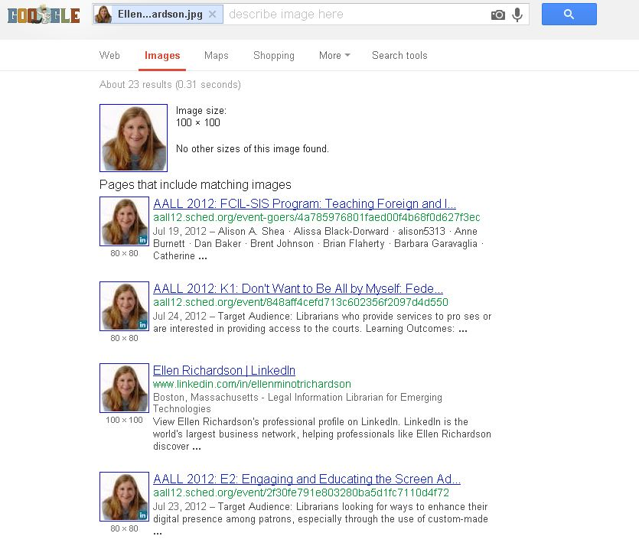
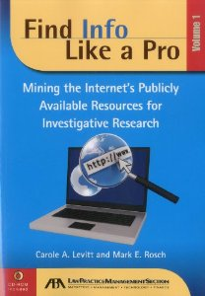
Make a Research Plan
Consult your secondary sources.
Got a photo? Try Google Reverse Image Search or TinEye

Slide 29
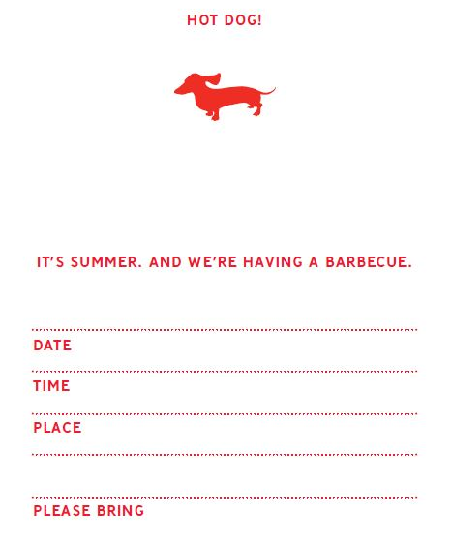
Keep a Research Log
Print/save everything.
Make sure the item has the date and web address.
Where/how did you find it? What parts of your strategy were successful?
Keep it clean. Stick to publicly available info without a discovery request.
found photos of your
^
When did you find it?
What’s the URL?
A printout containing the above info & notes on how you found & saved it.

Slide 30
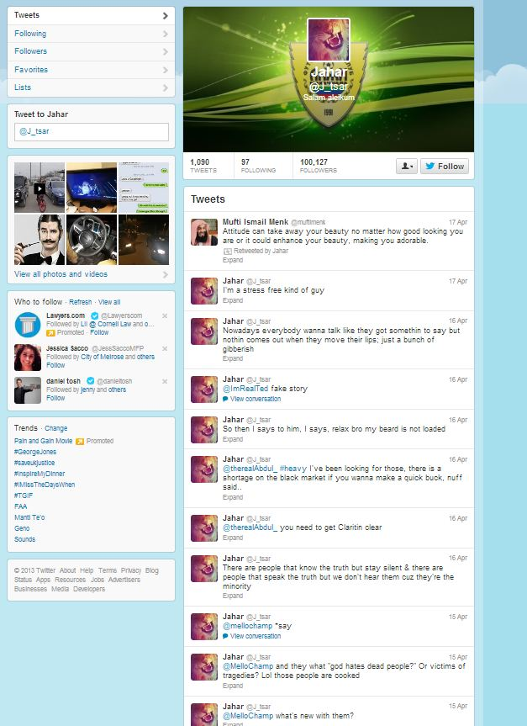
Refine, Double Check, & Update
Photo not obviously ripped from the headlines
Suspiciously low number of people following as compared to followed—where are his friends?
?
Postings going back more than a day
Notes:
Keep notes on what search terms work—it will make future searching easier. Double check what you’ve found to make sure it’s authentic. Update your research—the internet changes fast, so check in frequently for an ongoing case to see if there’s anything new out there.

Slide 31
Additional Thoughts on Teaching:
Seek out alums or local attorneys with practical experience
Social media is constantly evolving—don’t get too hung up on one search strategy
Do a live example (but check with the person first!)

Slide 32
Questions? Comments?
“[Social media evidence is] the wave of the future…It's going to change the way evidence is gathered in cases. It's already happening.”
- Harvard Law School professor and criminal defense lawyer Alan Dershowitz

Slide 33
Thank you!

